Slide 1
Overview
MGMT E-5072, Fall 2018
Data Literacy in the Age of Machine Learning

Slide 2
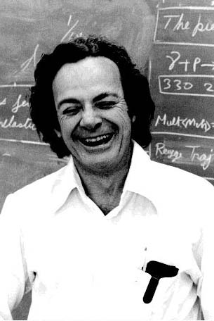
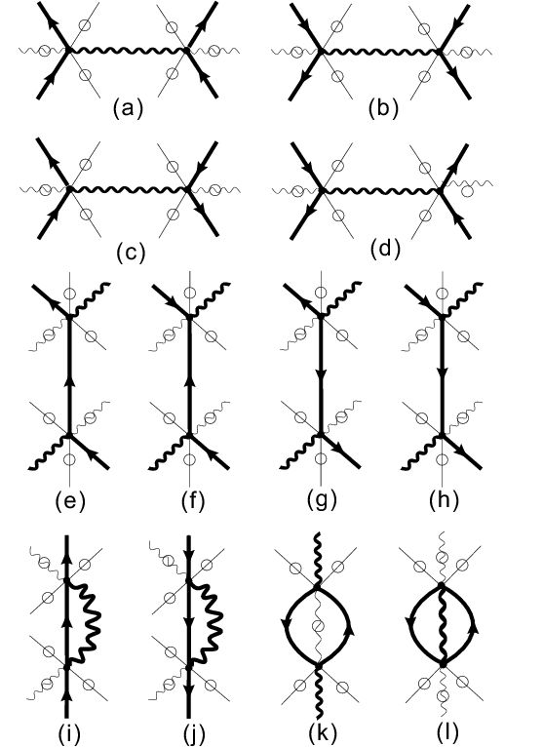
“To understand how subtraction works – as long as you don’t have to actually carry it out – is really not so difficult. That’s my position: I’m going to explain to you what physicists are doing when they are predicting how Nature will behave, but I’m not going to teach you any tricks so you can do it efficiently. … It takes seven years – four undergraduate and three graduate – to train our physics students to do that in a tricky, efficient way. …By explaining quantum electrodynamics to you in terms of what we are really doing, I hope you will be able to understand it better than do some of our students!” (Feynman, QED p.12)
Notes:
ML is a highly theoretical field. But it’s also easy to start doing some practical things in it. So our approach is going to be the one that Feynman took in QED. To understand what it is to *do* machine machine learning – not however the techniques for doing it efficiently.
Feynman is the co-creator of Quantum Electrodynamics – along with Julian Schwinger and Sin-Itiro Tomanga. QED alters Maxwell’s laws of electricity and magnetism to accord with the laws of quantum mechanics. So it explains everything but gravity and sub-nuclear physics.
"To understand how subtraction works -- as long as you don't have to actually carry it out -- is really not so difficult. That's my position: I'm going to explain to you what the physicists are doing when they are predicting how Nature will behave, but I'm not going to teach you any tricks so you can do it efficiently. You will discover that in order to make any reasonable predictions with this new scheme of quantum electrodynamics, you would have to make an awful lot of little arrows on a piece of paper. It takes seven years -- four undergraduate and three graduate -- to train our physics students to do that in a tricky, efficient way. That's where we are going to skip seven years of education in physics: By explaining quantum electrodynamics to you in terms of what we are really doing, I hope you will be able to understand it better than do some of the students!" (page 12, Feynman, QED)

Slide 3
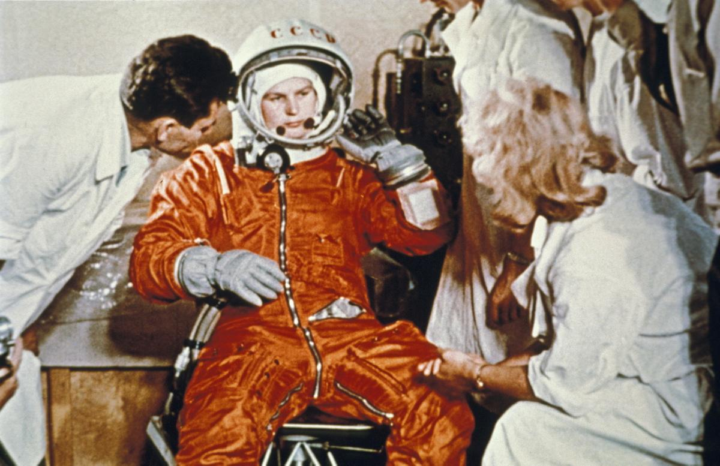
When you work with (and depend upon) others who know things you don’t and vice versa, you have to be able to work productively with them.
Together you can become more than just the sum of your parts.
Notes:
Valentina Tereshkova with the pre-launch team. Vostok 6, June16 – 19, 1963. First woman in space.
When you’re on a team where you depend on other people knowing things you don’t and vice versa, you have to be able to work productively with them. You don’t know everything; they don’t know everything. But together you become more than the sum of the parts.
So the second thing about the approach is to give you enough information to get started, learn more and understand it well enough so you can interact productively with your quant team.

Slide 4
“More broadly, companies must have two types of people to unleash the potential of machine learning. ‘Quants’ are schooled in its language and methods. ‘Translators’ can bridge the disciplines of data, machine learning, and decision making by reframing the quants’ complex results as actionable insights that generalist managers can execute.”
It’s not just about reframing the results but about framing the problem correctly in the first place.
An executive’s guide to machine learning, McKinsey Quarterly, June 2015
Notes:
Not just reframing the results but framing the problem correctly too.
E.g. how to take EMBERS data and connect it to business disruption?
How to take year, make, model, and trim and predict the used car’s price?

Slide 5
What makes these possible? Computational power, the availability of data, and …
Source: www.cbinsights.com
Notes:
There are lots of cool applications of machine learning in pretty much every industry. What ties these things together?
Lots of data, lots of computational power, and … and what?

Slide 6
… and learning without explicitly learning a set of rules. Think about how you learn to hit a tennis backhand or how you learn to recognize faces in photos. It’s not by writing down an explicit set of rules for doing these things.
Source: www.cbinsights.com
Notes:
Clippy worked (or mostly didn’t work) because he(?) memorized a lot of rules.
…In the old days (10 years ago?) we used to do these things (or try to do them) by writing down an elaborate set of rules. But rules are a lot of work and very fragile. Lots of exceptions, lots of knowledge is needed to keep them up.
But now we do it a different way. We’ve given up on rules. To learn something without explicitly learning the rules – that’s the domain of machine learning.
Examples: How Roger Federer hits a backhand; how you recognize a face in a photograph.

Slide 7
Definitions of machine learning
“A computer program is said to learn from experience E with respect to some class of tasks T and performance measure P, if its performance at tasks in T, as measured by P, improves with experience E.”
-- Tom Mitchell, Machine Learning (1997)
“[Machine learning is the] field of study that gives computers the ability to learn without being explicitly programmed.”
-- Arthur Samuels (1959)
Notes:
There’s been an explosion of research and results in the field of machine learning. And results in other areas of science, e.g., research on the brain has given machine learning some ideas.

Slide 8
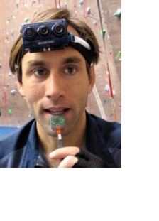
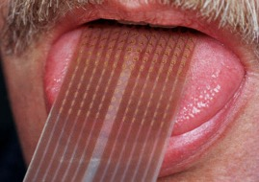
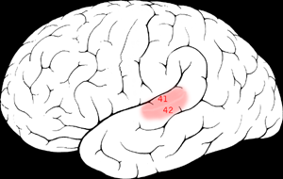
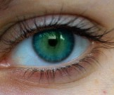
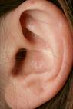
The one-learning-algorithm hypothesis
When you give 2 different brain areas the same inputs, you get the same outputs.
Sensory cortex learns to see.
+
Seeing with your tongue
When you give the same brain area 2 different inputs, you get 2 different outputs.
Auditory
Cortex
=
Conclusion/Hypothesis: No matter the brain area, it’s doing the same thing – i.e., running the same algorithm.
Auditory cortex learns to see.
Source: Andrew Ng; BrainPort; Martinez et al; Roe et al.
Notes:
Assumptions
Hearing and sight are due to a certain orchestra of signals in an area of the brain (hearing signals and sight signals).
The structure of an area of the brain determines the computation/algorithm that can be performed by it.
Case 1: When you give two different brain areas the same inputs, you get the same outputs.
Input = visual data (translated into electrical shocks on the tongue)
Brain area 1 = sensory cortex
Output = sight signals
Input = visual data
Brain area 2 = visual cortex
Output = sight signals
Case 2: When you give the same brain area two different inputs, you get two different outputs.
Input 1 = auditory data
Brain area = auditory cortex
Output 1 = hearing signals
Input 2 = visual data
Brain area = auditory cortex
Output 2 = sight signals
Conclusion/Hypothesis: No matter the brain area, it’s doing the same thing – i.e., running the same algorithm. Hence the one-learning-algorithm hypothesis.

Slide 9

Deep Learning
Universality Theorem: A three-layer neural network can calculate any function (to a close approximation).
CAUTION: That a function can be calculated doesn’t mean it can be learned.
Check out Michael Nielsen’s online book for more information: http://neuralnetworksanddeeplearning.com/chap4.html
Source: GoogleBrain
Notes:
“One of the holy grails of machine learning is to automate more and more of the feature engineering process.” (Domingos, p.6)

Slide 10
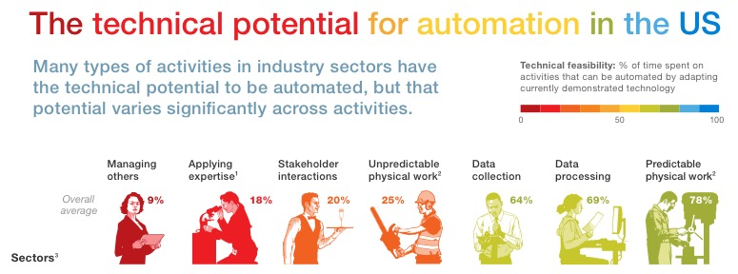
Source: McKinsey Quarterly, July 2016
Notes:
Frank Chen’s Frame for what you can do with AI (or what will happen when the following things become doable?)
Move things from point A to point B without human intervention.
See and understand the world.
Create content
Predict the future
Automatically optimize complex systems
Understand language.

Slide 11
The singularity
“Let an ultraintelligent machine be defined as a machine that can far surpass all the intellectual activities of any man however clever. Since the design of machines is one of these intellectual activities, an ultraintelligent machine could design even better machines; there would then unquestionably be an ‘intelligence explosion,’ and the intelligence of man would be left far behind. Thus the first ultraintelligent machine is the last invention that man need ever make, provided that the machine is docile enough to tell us how to keep it under control.” (I.J. Good, 1965)
Notes:
Assumptions
An ultra intelligent machine is one that can surpass the intellectual activities of any person, however clever that person may be.
An ultra intelligent machine has/can been created.
The design of machines is one of the intellectual activities of an ultra intelligent machine.
An ultra intelligent machine can build a machine that is even more intelligent than it.

Slide 13
Source: www.cbinsights.com

Slide 14




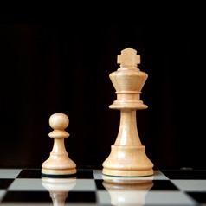


The components of intelligence
Perception
Learning
Reasoning
Abstraction
Rules–Based Systems
No
No
Yes
No
Machine Learning
Yes
Yes
No
No
Deep Learning
Yes
Yes
No
Yes
Contextual Adaptation
Yes
Yes
Yes
Yes
Source: DARPA
Notes:
The components of intelligence.
Situations where you can’t specify the rules explicitly.
Knowing that, knowing how, and knowing why.

Slide 15
Prerequisites
We do not use any advanced mathematics in this course. If you’ve taken the SAT or the GRE you’ve already come across math that is much more advanced than anything you will need for this course.
Alternatively, if you’re comfortable working with spreadsheets (nothing fancy, just basic formulas and manipulations like sorting rows), you will be comfortable with all of the mathematics used in this course.
Hands-on learning is encouraged using the Orange data science platform (https://orange.biolab.si/) – a visual way to solve machine learning problems without programming.
For those with some programming knowledge of Python, we provide Jupyter notebooks that can be used to build, run, and experiment with machine learning models.
NOTE: Python knowledge is NOT a prerequisite for the course. The course assignments (homework, group presentation, and the final exam) do NOT require any Python programming.

Slide 16
What We’ll Cover in the Course
Part 1: The Mechanics of Prediction. In Part 1 we’ll dive right into machine learning, unpacking the key concepts. We’ll apply these concepts to make predictions from real datasets. We’ll cover the basic techniques of machine learning – regression and logistic regression – and get a feel for the practical things that data scientists do. We’ll round out this part by taking a look at more advanced machine learning techniques.
Part 2: The Science of Machine Learning. In Part 2 we’ll learn to systematically evaluate the performance of machine learning models. We’ll understand how to define performance and measure it. We’ll use this knowledge to not only build the right machine learning models but build them right.
Part 3: The Art of Machine Learning. In Part 3 we’ll tackle the art of machine learning – how to get the most predictive bang for our data buck. In other words, we’ll learn about how to make the most out of the data we have.
Part 4: Select Topics in Machine Learning. Finally, in Part 4 we’ll cover select topics in machine learning: segmenting customers, spotting fraud, detecting spam, and building a machine learning system.

Slide 17
Outline of topics
Part 1: The Mechanics of Prediction
Introduction to machine learning
What makes machine learning possible?
What's different about machine learning?
How does it work?
The types of machine learning
Problems that are particularly suitable for machine learning and ones that are not (at least not yet)
The business value of machine learning
Predicting a numerical value: Regression
Linear regression (using single and multiple features)
Non-linear regression (using single and multiple features)
Measuring the performance of regression models
Training and Test data sets
Performance measures
Predicting a categorical value – part 1
Logistic regression (using single and multiple features)
Non-linear logistic regression (using single and multiple features)
Predicting a categorical value – part 2
Support Vector Machines
Neural Networks
Decision Trees
Random Forests
Measuring the performance of logistic regression models. Precision, recall, and accuracy.
Part 2: The Science of Machine Learning
Preparing data for prediction
Data pre-processing and cleaning
Systematic visualization of data sets
Systematic investigation of data sets
An overview of models
The menu of different machine learning models, why we need them, and when to use them. (The problem of having enough data; the no-free-lunch theorem.)
Overfitting and underfitting; what they are and how to handle them.
Comparing rule-based, statistical, and machine learning-based approaches to prediction.
Finding the optimal hyper-parameters of a model
Models, parameters, hyper-parameters
Training, validation, and test datasets
Model complexity
Tuning a model's hyper-parameters (including k-fold cross validation)
Measuring and improving model performance
Precision, recall and other measures of prediction capability (again)
Bias and variance
Learning curves to determine model bias and variance
Techniques for improving model performance

Slide 18
Outline of topics (contd.)
Part 3: The Art of Machine Learning
Feature selection – tree based, sequential selection, and dimensionality reduction.
Feature engineering – combining features, manufacturing features.
Part 4: Select Topics in Machine Learning
Unsupervised models -- similarity and clustering.
The surprising power of ensemble models
Building a spam filter using a Naïve Bayes model
Learning from images and text
The promise of deep learning

Slide 19
What is not covered in this course
We will not cover the details of machine learning algorithms – how they are designed or how to make them efficient.
We will not cover the theoretical underpinnings of machine learning – probability, statistics, statistical inference, numerical computation, etc..
We will not cover computer science topics such as data structures, algorithm design, search, etc..
We will not cover deep learning and associated platforms like TensorFlow, Keras, PyTorch, Theano, etc.
We will not cover data architecture/engineering for implementing machine learning systems at scale.
This is not a course for students seeking to learn the theoretical and mathematical underpinnings of machine learning.

Slide 20
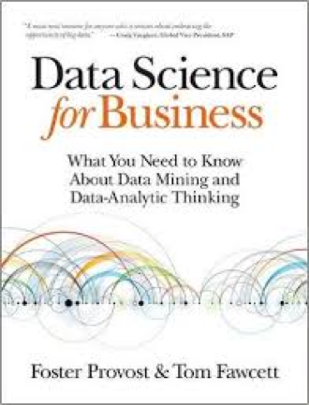
Optional textbook
Nice alternative view – useful when you’re learning something new.
Strong on the business aspects of data science – chapters 1, 2, 11, 13, and 14.
Additional book suggestions:
DataSmart by John Foreman
AIQ by Nick Polson and James Scott
The Master Algorithm by Pedro Domingos
Lots of useful blogs/websites:
Adam Geitgey (Machine Learning is Fun)
Jason Brownlee (Machine Learning Mastery)

Slide 21
By the end of this course you’ll be able to…
List the types of problems that can be solved using machine learning.
Understand the seven key steps to solving any machine learning problem.
Apply machine learning techniques such as regression and classification to solve a variety of business problems using real-world data.
Build strong intuitions about machine learning techniques by implementing them in a hands-on interactive programming environment.
Systematically investigate and improve the results produced by machine learning models.
Collaborate productively with your data science team.
Keep up with the rapidly progressing field of machine learning and AI.

Slide 22
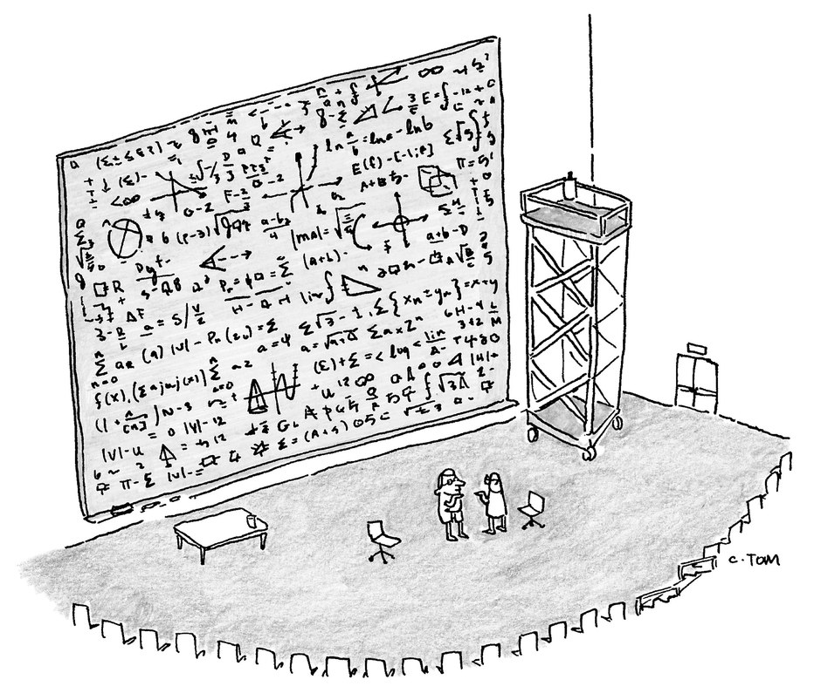
“The math is right. It’s just in poor taste.”
New Yorker, August 28, 2015

Slide 23
The Important questions
How do you take available data and translate it into a business problem you can solve?
How do you know your machine learning system is not learning too little or too much?
What’s the right measure of a machine learning system’s performance?
Understanding the business context is a critical component of success in building machine learning systems.
Notes:
What data do you use?
How do you get data into the right “machine learning” format?
How do you know you’re not learning too much or too little?
How do you measure the performance of your learning system?
Instead of our old fashioned data analysis, here’s what we do instead.
A systematic way to answer the question of system performance is to use the concepts of BIAS and VARIANCE.
So what are bias and variance? Only the two most important concepts ever in machine learning!
But first, a look at the data.

Slide 24
Scoring and Evaluation
Homework assignments - 60%
Group assignment/presentation – 20%
Final exam – 20%
Course materials will be available on Canvas/GitHub

Slide 25
Tour of Orange
https://orange.biolab.si/

